Slide 1
Report 04/23/2020
P. Hacker

Slide 2
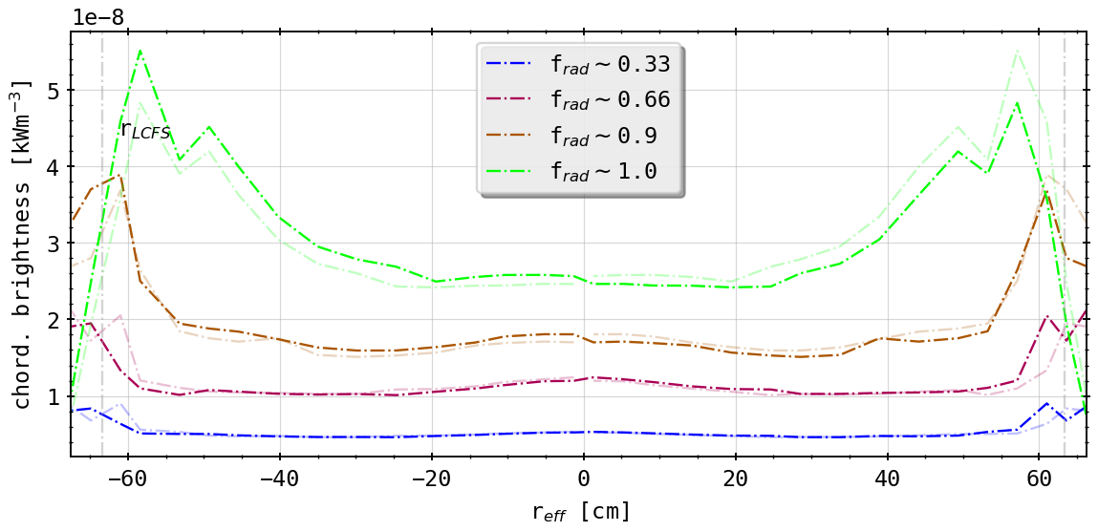
Previously on: Why is a STRAHL Profile Asymmetric?
forward integral on Bolometer lines of sight from intrinsically symmetric radiation profile in STRAHL yields asymmetric chordal brightness profile
(forward integration of STRAHL simulations)

Slide 3
Agenda: Line of Sight Geometry and Local Emissivity
investigate intrinsic dependency of chordal profile to line of sight (LoS) geometry
therefore deliberately change detector arrangement/geometry in pre-processing:
fixing possible non-planar distribution; relative to plane created by one side of detector fan and aperture normal vector (only HBCm possible, aperture centered)
transforming detector fan from tilted plane in toroidal direction to vertical arrangement at 107.94° (tor. angle)
tilting detector fan in poloidal direction up/down by -1.0° <-> 5.0°
changes in geometry matrix from LoS geometry used in forward integration of poloidally symmetric STRAHL simulation results (line radiation of impurity carbon)

Slide 4
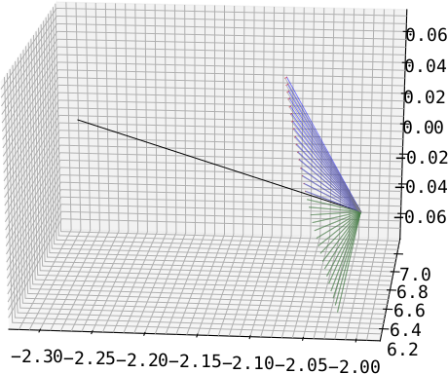
1.: ‘Fix’ Bolometer Planar Error
guided by lower half of detector array (green)
observe difference (red) between opposite channel (e.g. CH#0 <-> CH#31) through rotating around aperture normal by 180° and measuring angle
transforming second channel through rotating it by angle from before (blue)
only really easy for HBCm, because central aperture axis alignment; VBC cameras not possible
aperture
‘fixed’
HBCm
guide

Slide 5
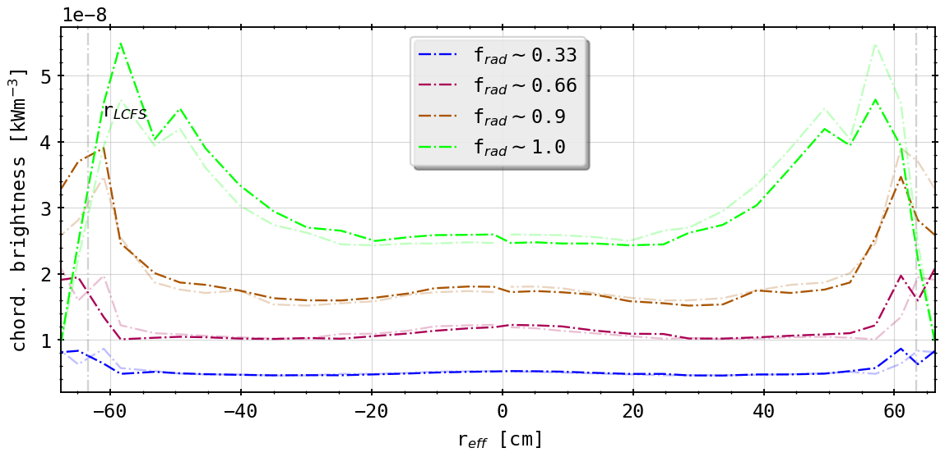
‘Standard’ Case vs. Planar Fix
(forward integration of STRAHL simulations)
(forward integration of STRAHL simulations with ‘fixed’ LoS)
virtually no changes?

Slide 6
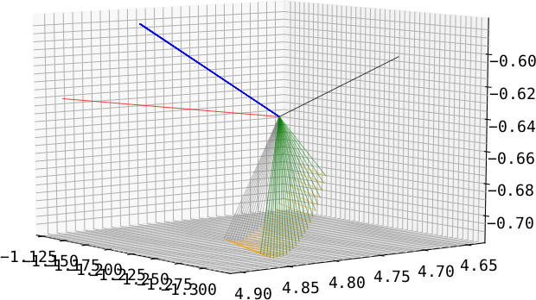
2.: Toroidal Transformation to Axis Plane
guide is normal of plane constructed by detector fan (blue)
transforming all channels so that normal points in/at toroidal direction (red)
transformation for each channel individual (see previous argument (1.)) (orange)
done for all cameras individually
old normal(s)
aperture normal
target normal
old fan
new fan
VBCr

Slide 7
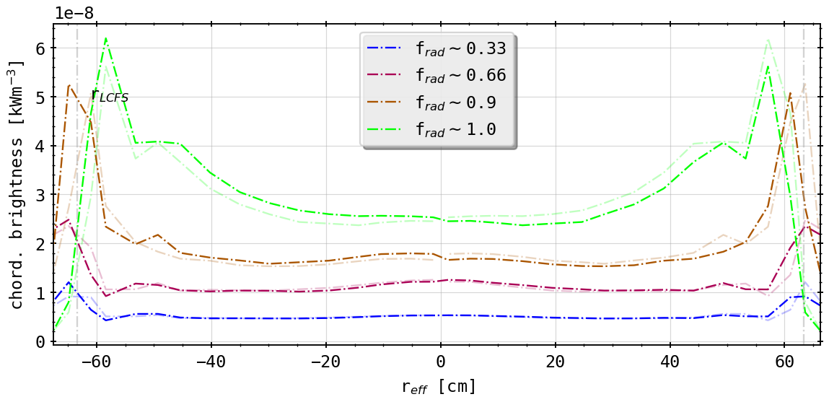
‘Standard’ Case vs. Toroidal Transformation
(forward integration of STRAHL simulations)
(geometry matrix in Bolometer plane at 108° with symmetric LoS orientation)
qualitatively small changes: SOL radiation zones now more peaked
radially no shift/difference in forward calculation
comparatively same level of asymmetry remains (fault in own calculation?)

Slide 8
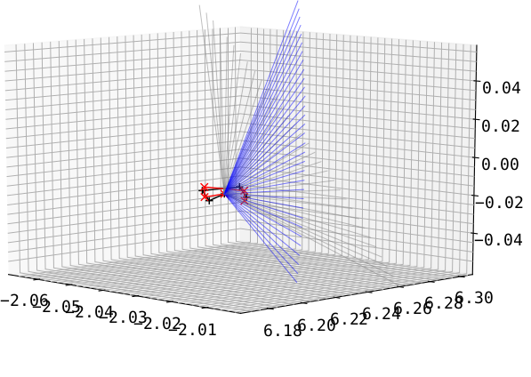
3.: Tilting the Detector Fan Up/Down
take results of (2.) and tilt the entire fan including the aperture poloidally (grey to blue and black to red)
HBCm
(results for (2.) with aperture change included)

Slide 9
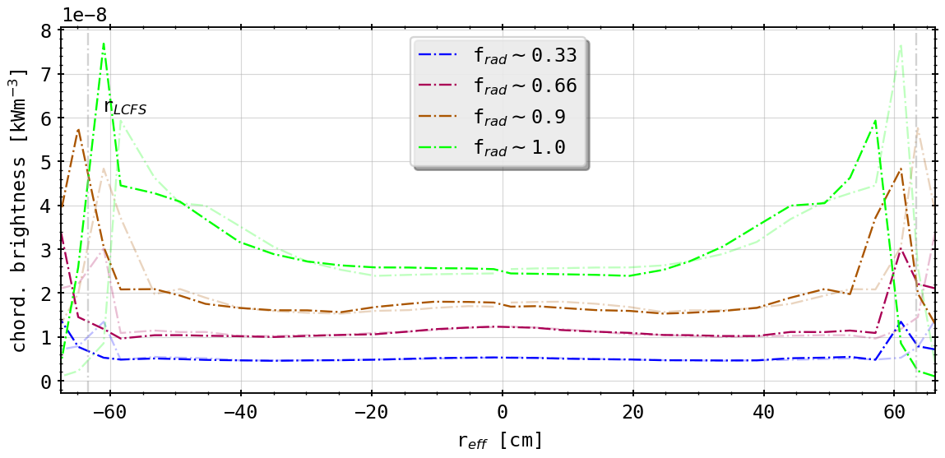
‘Standard’ Case vs. Toroidal Transformation and Tilt
(forward integration of STRAHL simulations)
(geometry matrix in Bolometer plane at 108° with symmetric LoS orientation and -1.0° tilt (up))
asymmetry becomes stronger
left hand side or brightness for ‘negative’ radii more peaked
alignment with fluxsurfaces better
also radial movement of radiation peaks further out (instead of inwards)

Slide 10
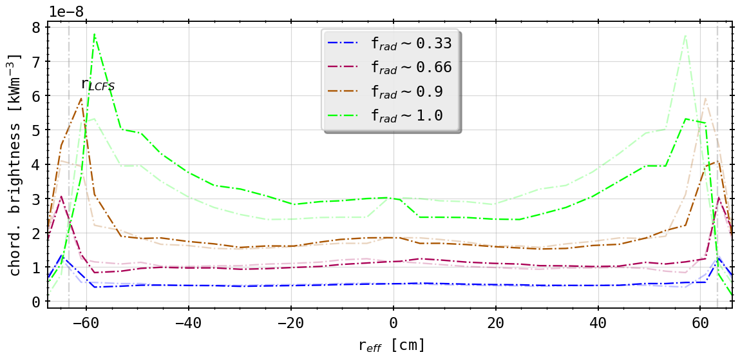
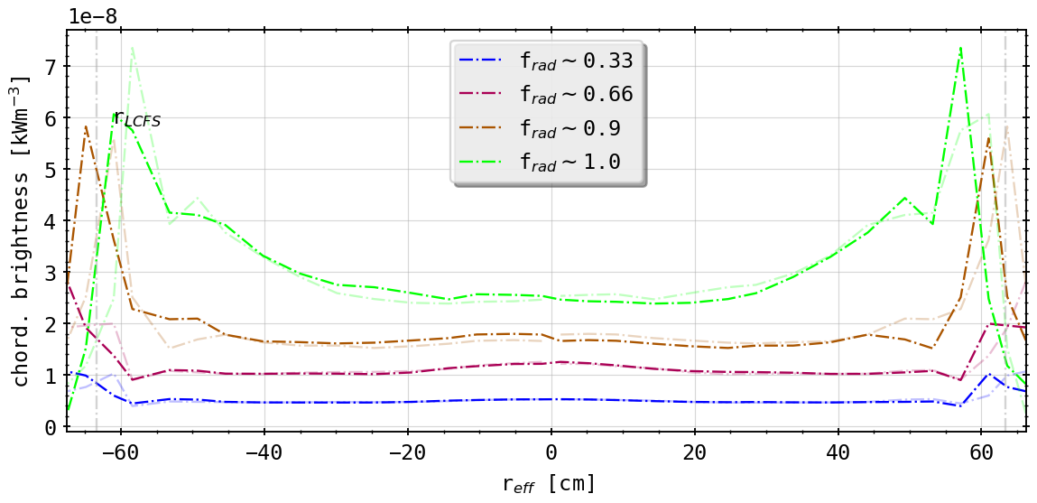
Different Tilts
(0.5° tilt (down))
(-0.5° tilt (up))
asymmetry switched around
alignment better now upside (tilt down!)
likewise radial movement as before!

Slide 11
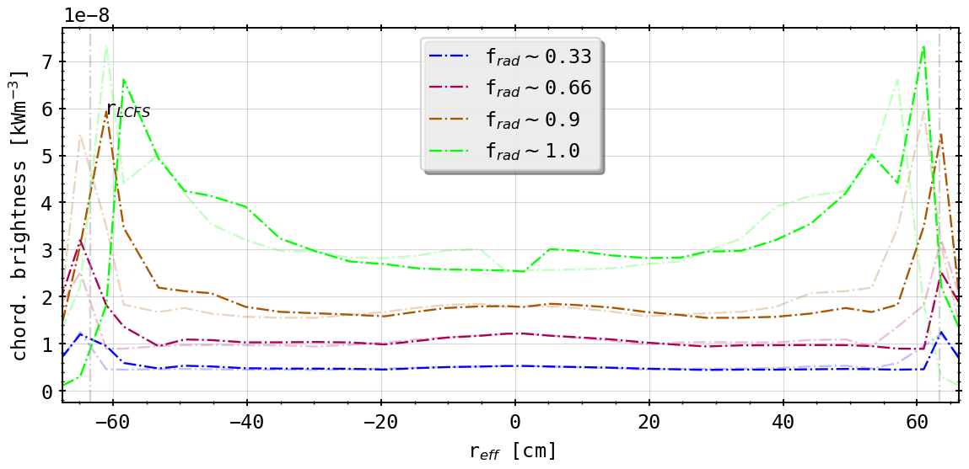
Different Tilts
(1.0° tilt (down))
(-1.0° tilt (up))

Slide 12
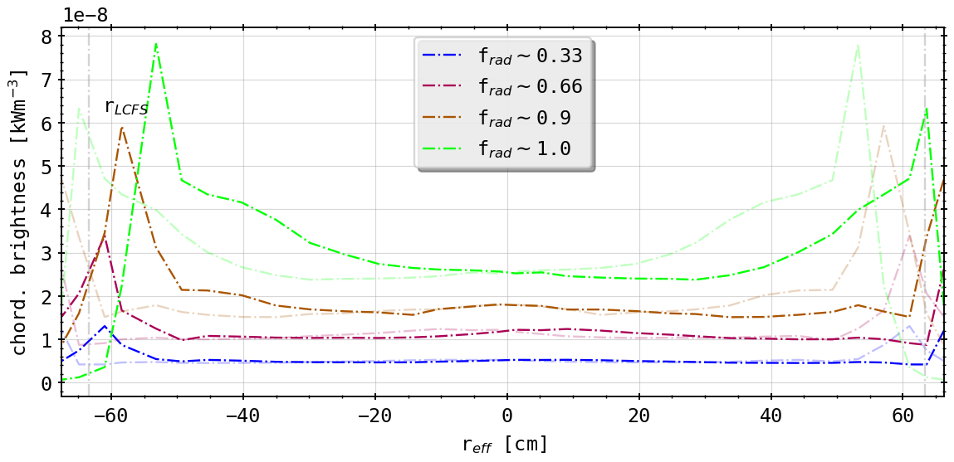
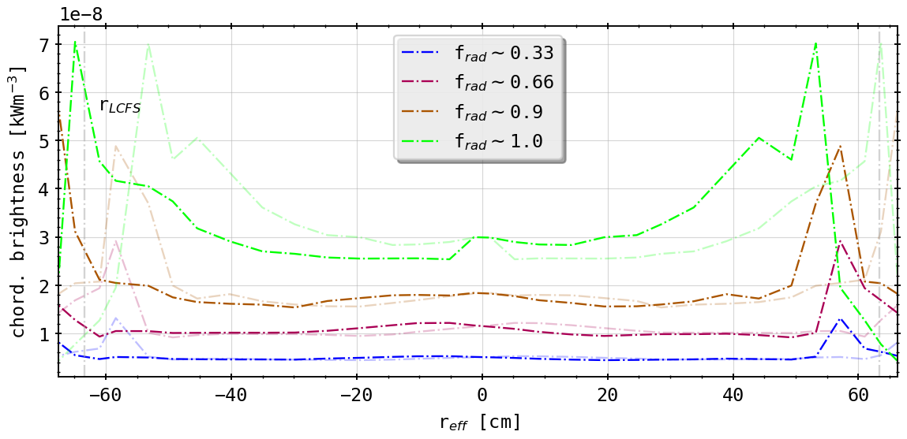
Different Tilts
(2.5° tilt (down))
(-2.5° tilt (up))

Slide 13
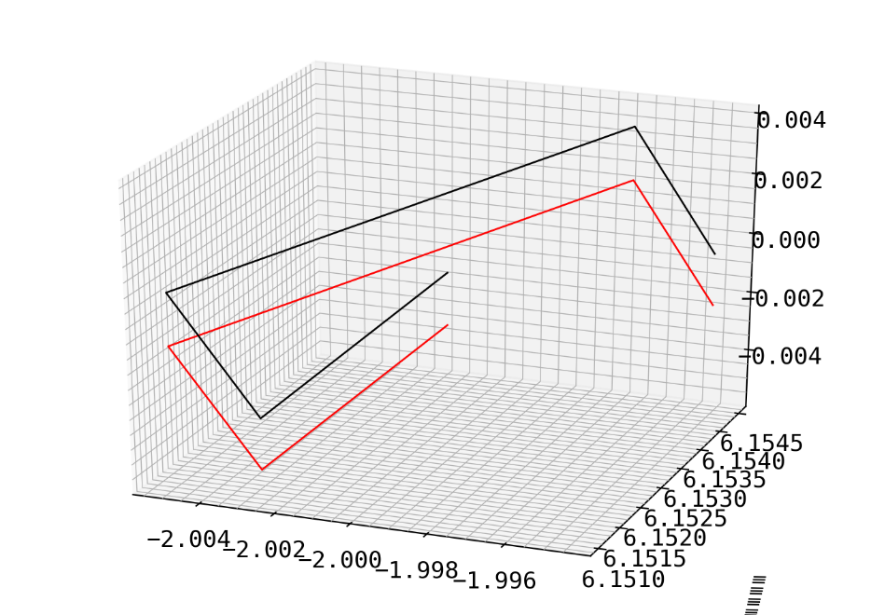
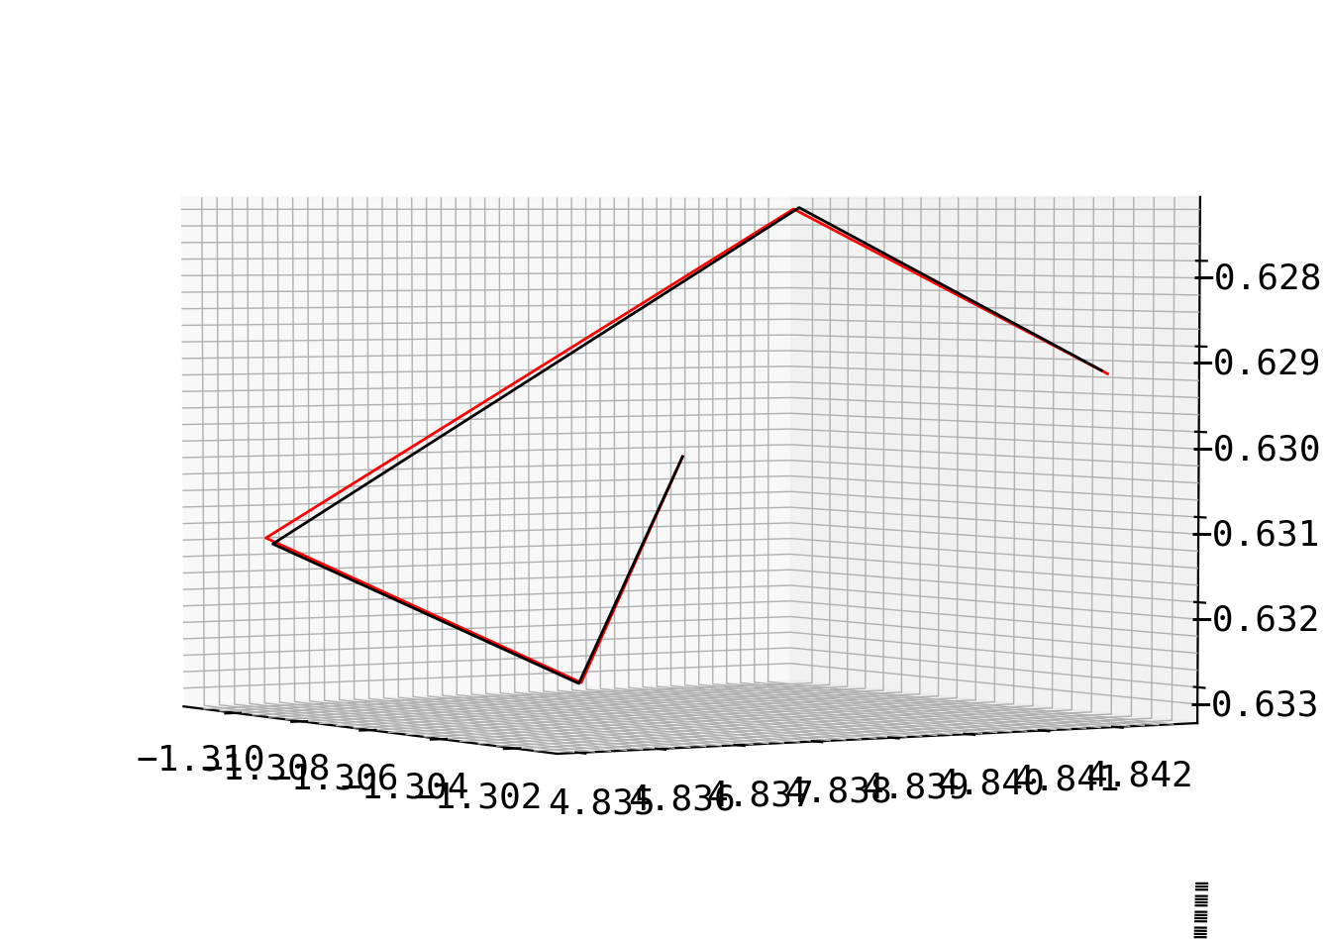
Centering of Aperture and Random Error
center the aperture center (black) on z = 0 axis and shift entire array accordingly to red
introduce measurement error to aperture and detector positions of maximum 0.1mm (randomly distributed) and see resulting tilt in camera fan
degree of tilt 0.5° - 2.0°, but omnidirectional
aperture
centered
perturbed
aperture

Slide 14
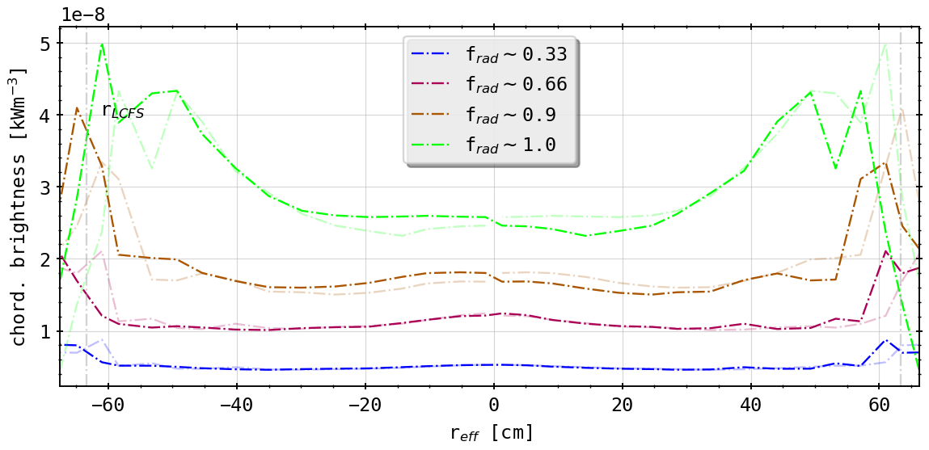
Standard v. Centered Aperture
(standard case)
(centered aperture)
introduction of some more asymmetry close to SOL
possibly resolvable by one of earlier transformations

Slide 15
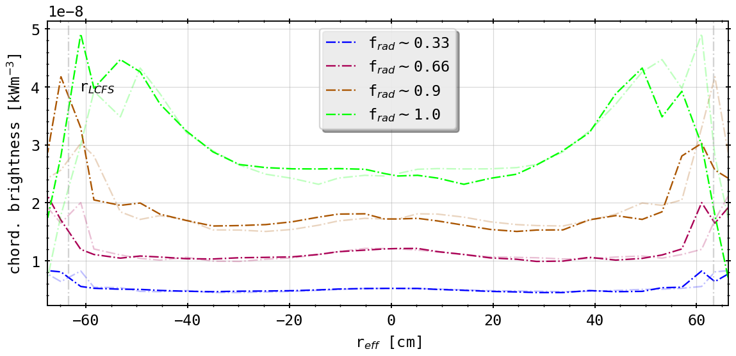
Standard v. Centered Aperture
(centered aperture)
(centered aperture and ‘planar fix’)
still not symmetric, aperture normal and LoS fan tilted still

Slide 16
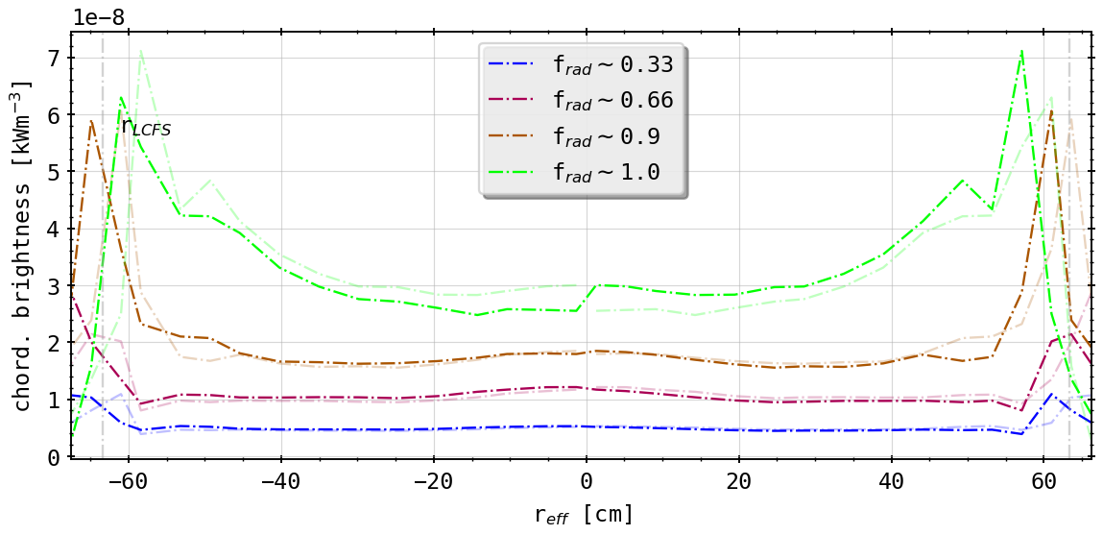
Standard v. Centered Aperture
(centered aperture)
(centered aperture and toroidal transformation)
???

Slide 17
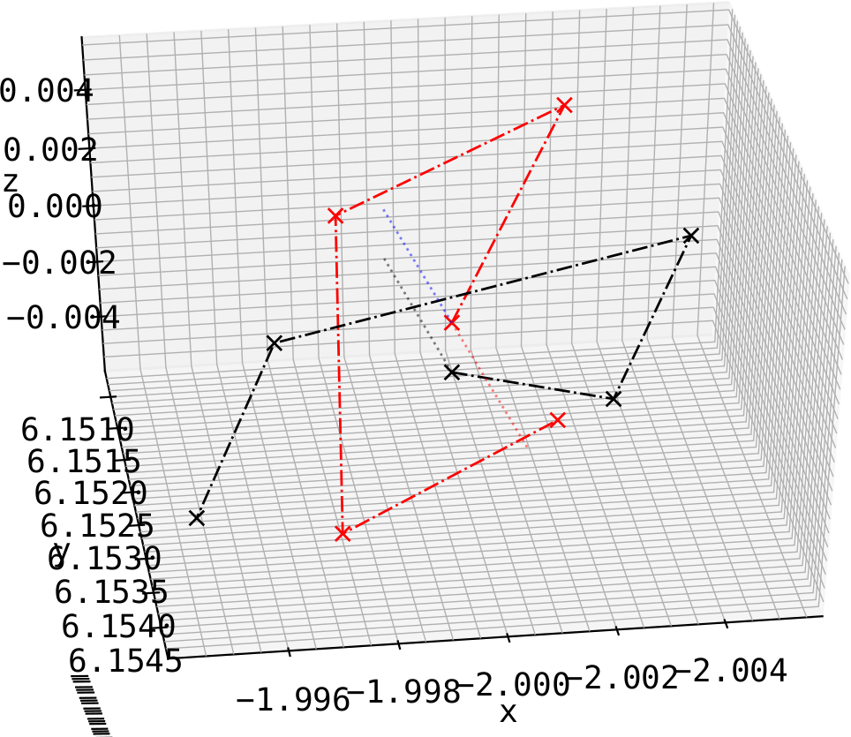
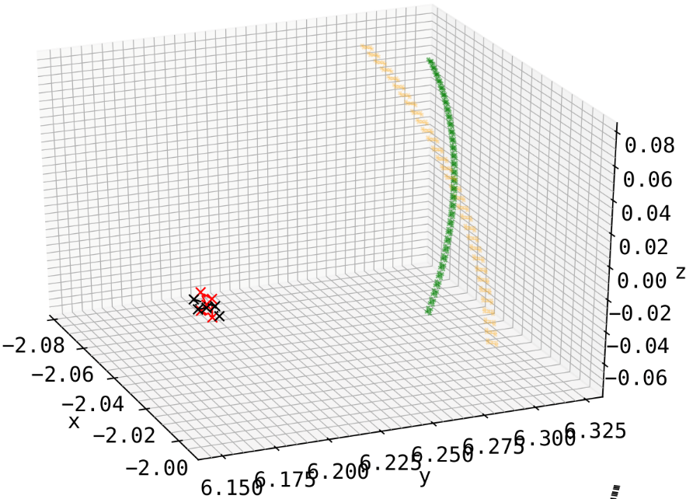
Setup
creating symmetric, upright, rectangular aperture at location of old one (HBCm) with plane normal exactly pointing at (0.0, 0.0, 0.0)
detector array equidistant to aperture and to each other behind pinhole and in-line with plane normal
detector plane normal has no angle with pointing vector between aperture and center
artificial
HBCm
HBCm
apt.
artificial

Slide 18
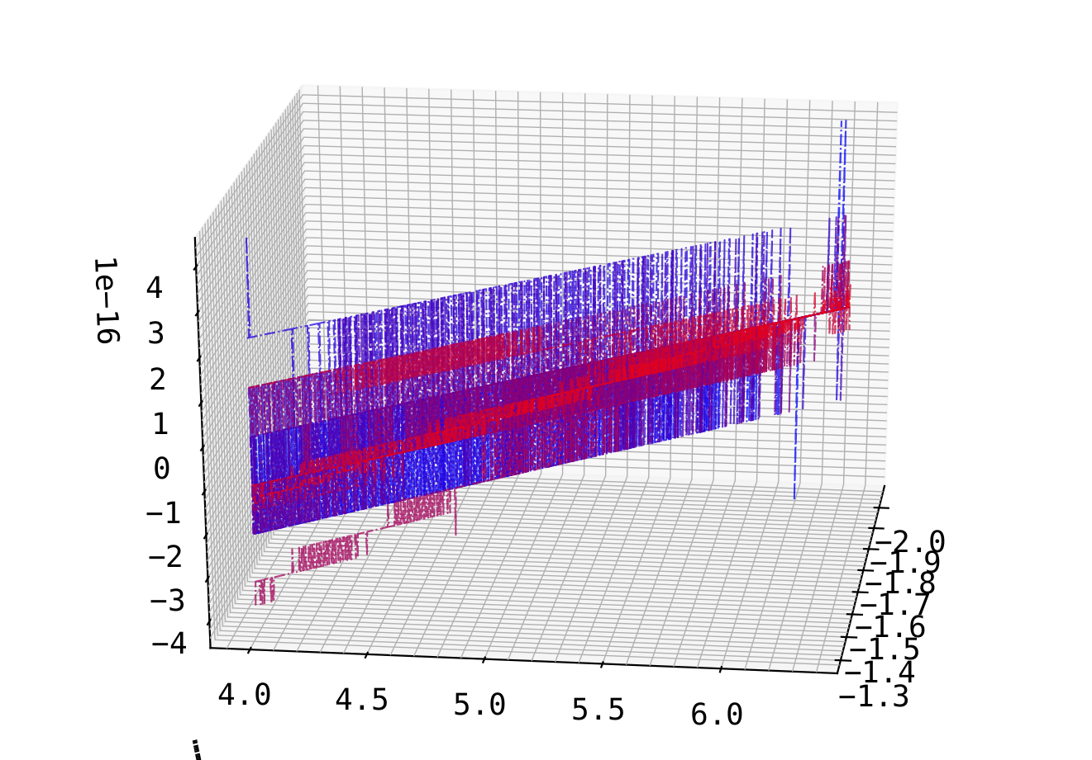
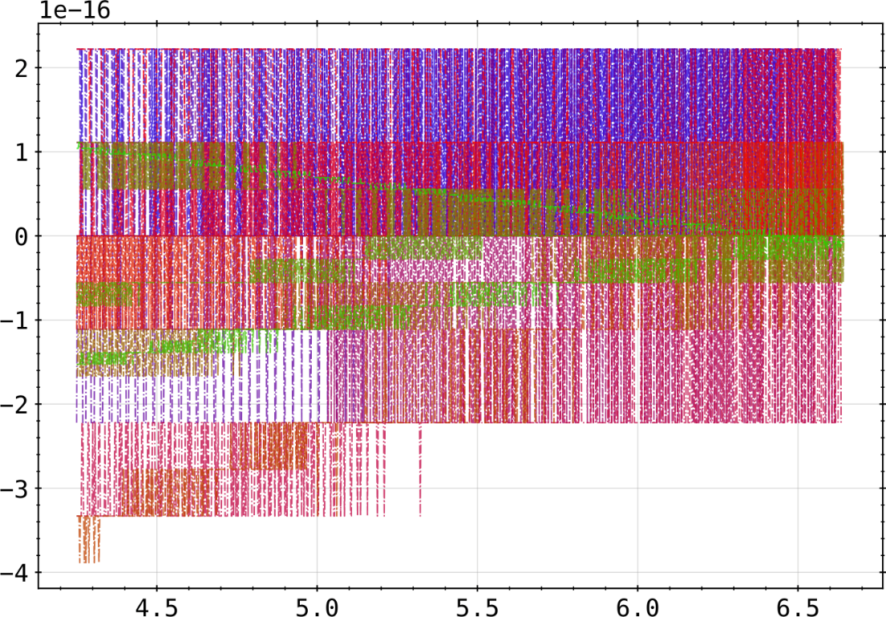
Setup
Lines of sight from this configuration are symmetric (top-bottom) down to the numerical accuracy of a 53 bit encoded double precision float
sum of opposing channels (0-31, 1-30 ,…) in (x,y,z)-space
sum of channels (0-31, 1-30 ,…) in (r,z)-space

Slide 19
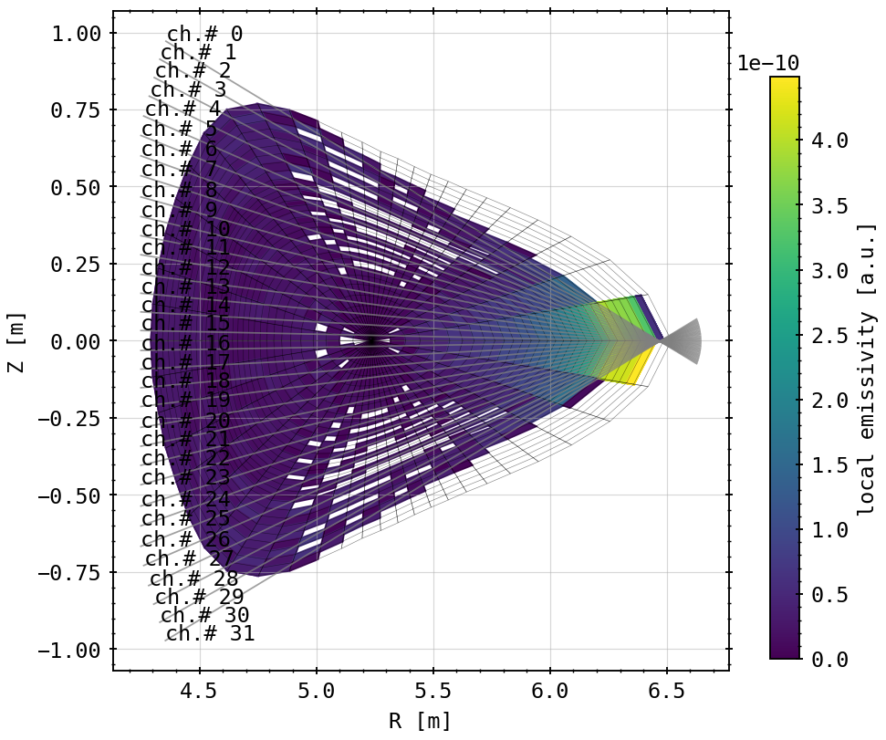
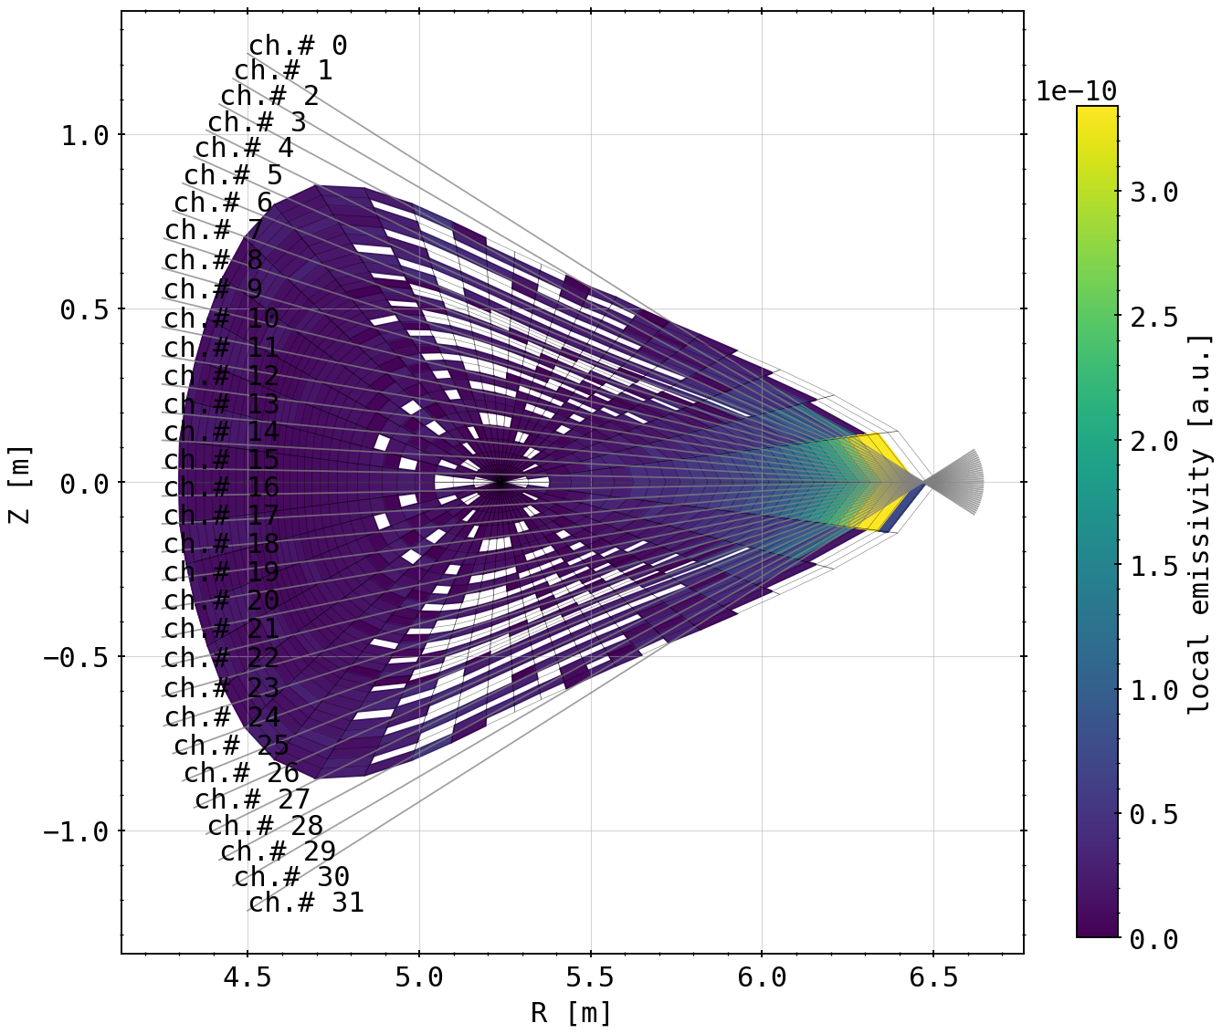
Emissivity on Fluxsurface Cells
almost entirely symmetric emissivity distribution on fluxsurfaces, except artifact in front of aperture
slightly wider opening angle on line of sight-fan

Slide 20
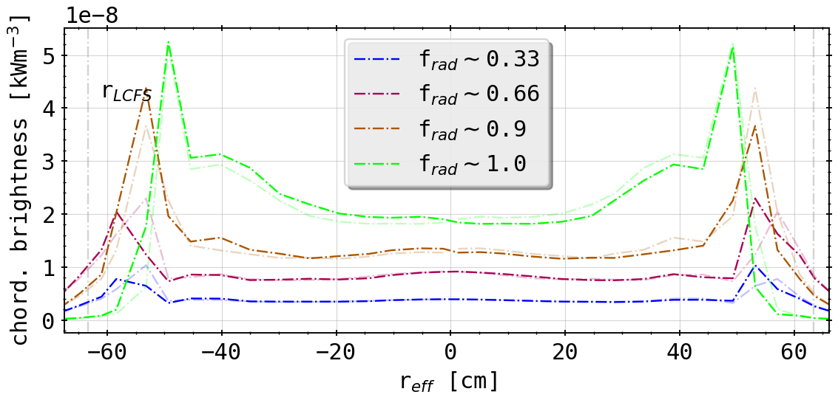
Forward Integral: Standard Case vs. Artificial Array
(forward integration of STRAHL simulations)
(forward integration of STRAHL simulations of artificial, fully symmetric horizontal camera array)
still not entirely symmetric, deviance in fluxsurface geometry? (pinhole is located not exactly at 108 degrees, but rather 107.9)
geometrically very different to ‘standard’ case
more peaked towards edge
far inside the LCFS even for low radiation fraction cases

Slide 21
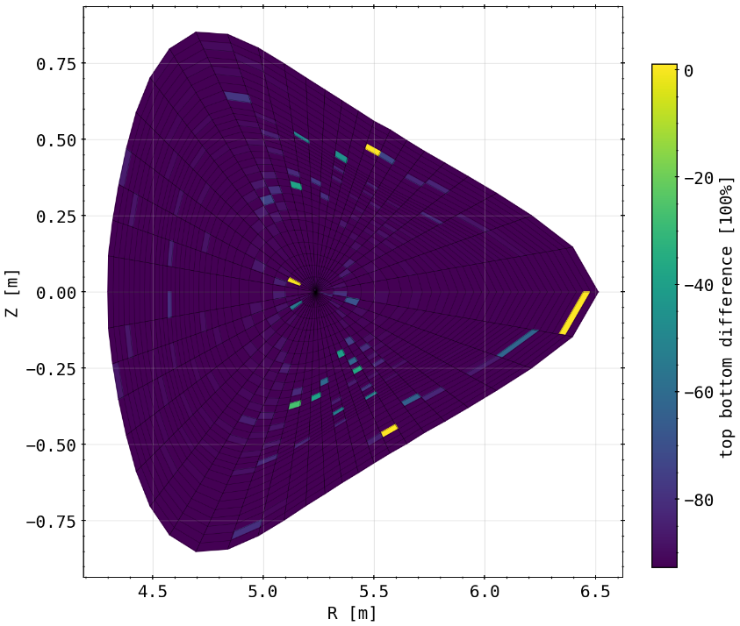
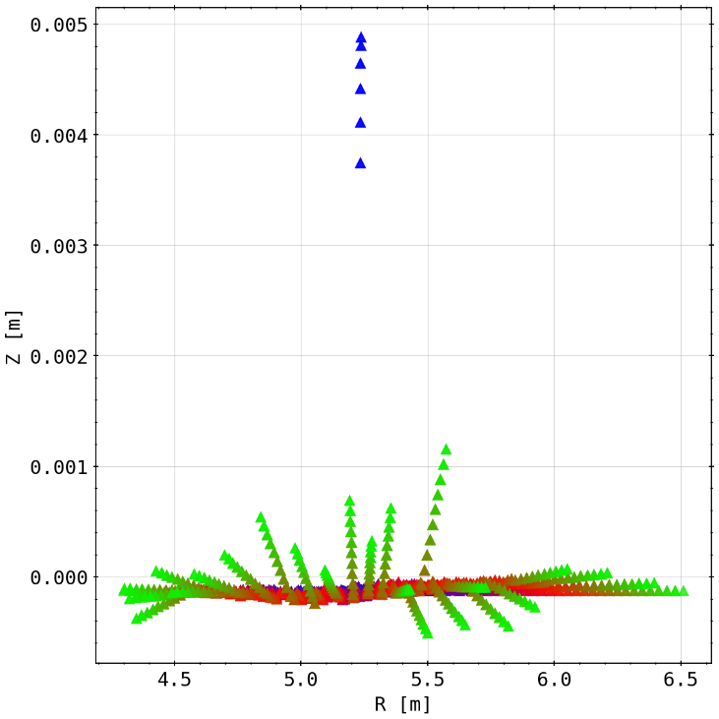
Symmetry of Emissivity Matrix and Mesh
checking the symmetry (read: top-bottom congruence) of the emissivity matrix
slight deviances overall, especially some cells not touched by channels at all (equaling 100% difference here)
checking symmetry mesh matrix
blue to red to green means further outside the magnetic axis, i.e. ‘larger’ fluxsurfaces/fluxtubes
entire mesh dispositioned below (still oriented around magnetic axis)
increasing deviance with distance

Slide 22
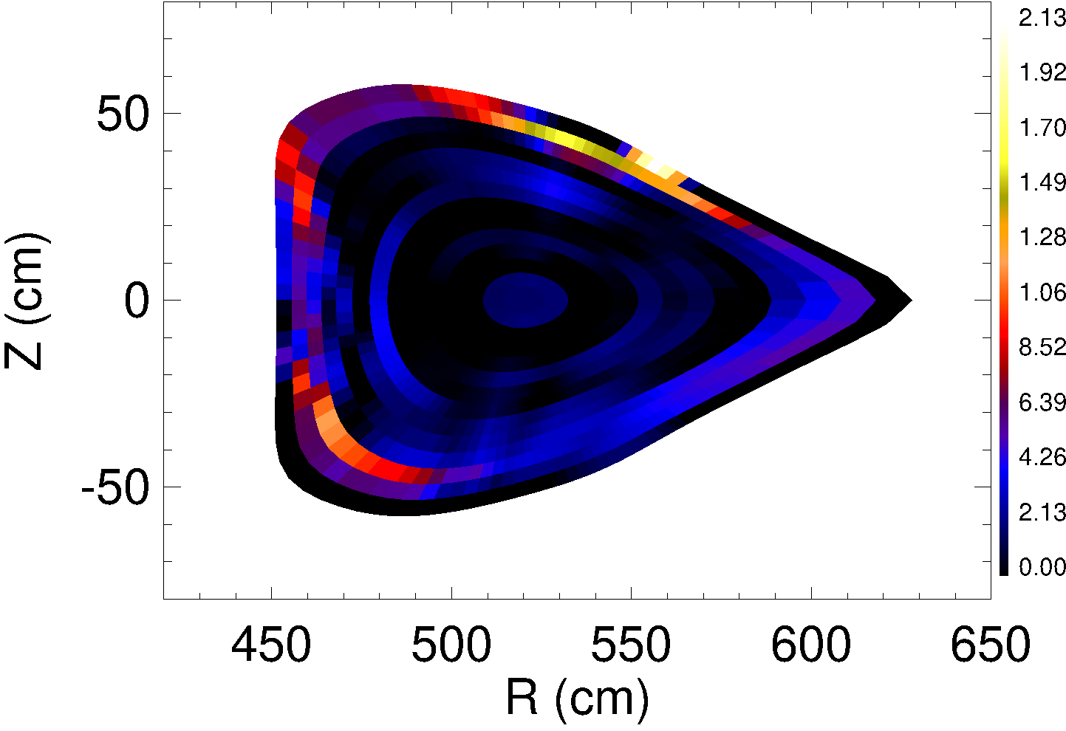
2D Tomography: First Results
geometry files are now being read correctly
anisotropy factors set to 1.5 for divertor (?) or island and 0.8 for core-like regions
t = 3.421s <-> frad=100%

Slide 23
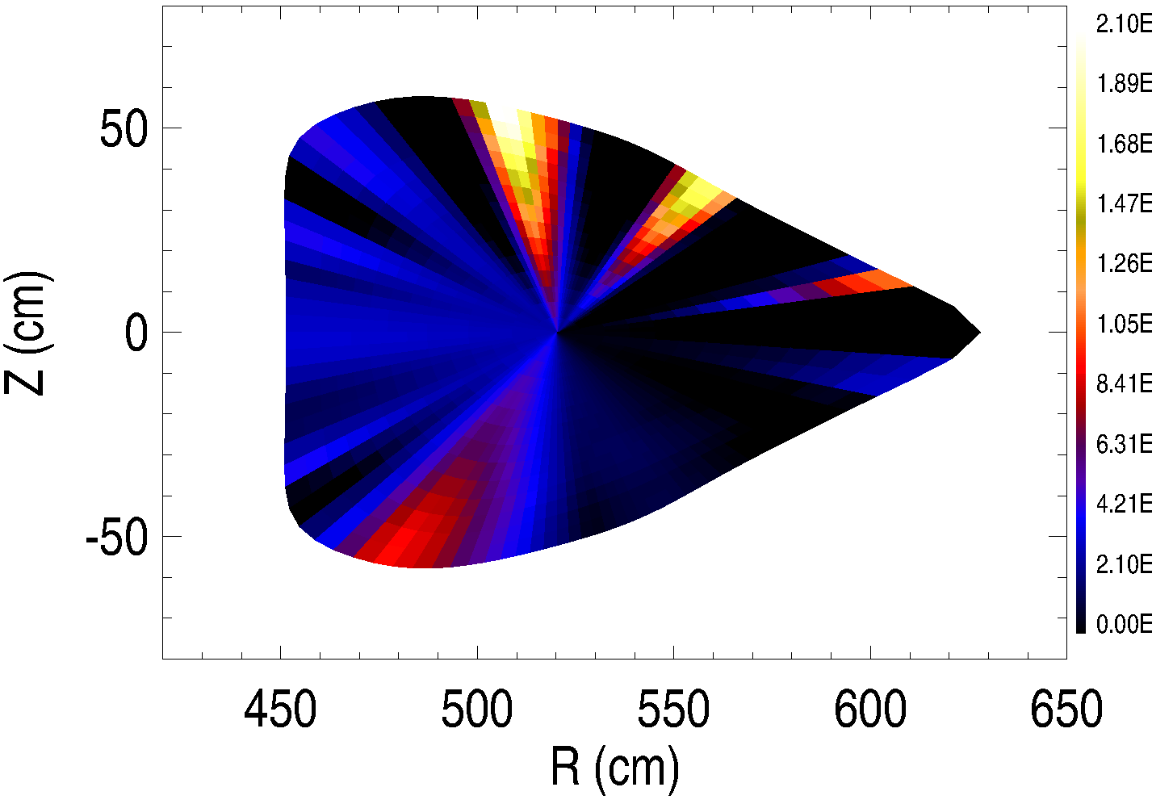
2D Tomography: First Results
anisotropy factors set to 1.0 and 1.0
again: t = 3.421s (frad=100%)

Slide 24
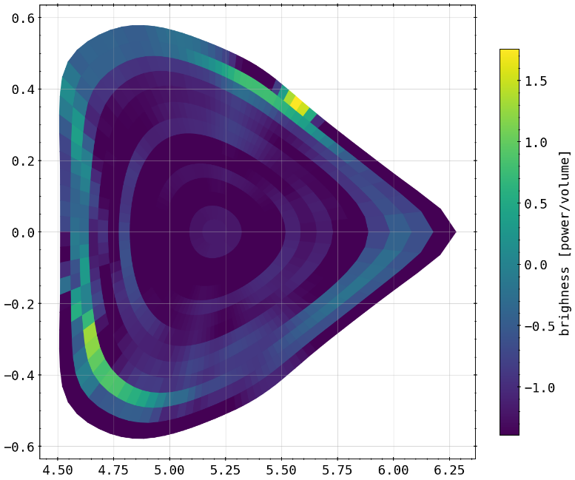
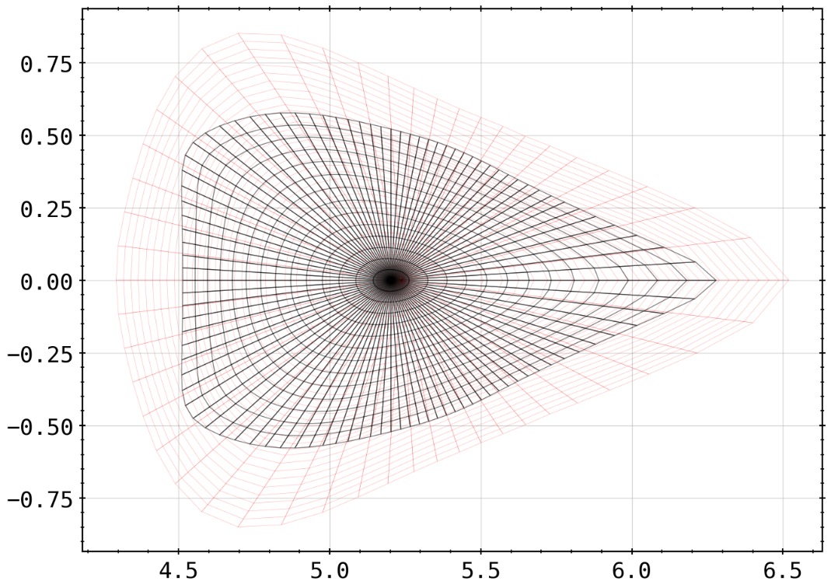
Forward Calculations Towards Phantom Tests
now reading from MFR tomography and adapting to different geometry
next step: set up forward calculation of chordal brightness profile from the 2D results of tomography as shown before

Slide 25
Agenda
Not in order:
start to finish RSI paper (for internal reviewing)
understand anisotropy factor, hence structure of tomogram
create and feed phantom radiation profiles to inversion method using that knowledge

